Slide 1








TEAM
THE SPACE STRIKERS
OPEN SCIENCE STORYTELLING

Slide 2

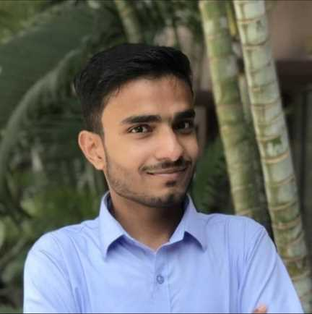
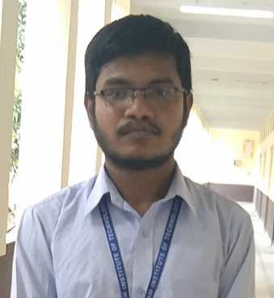
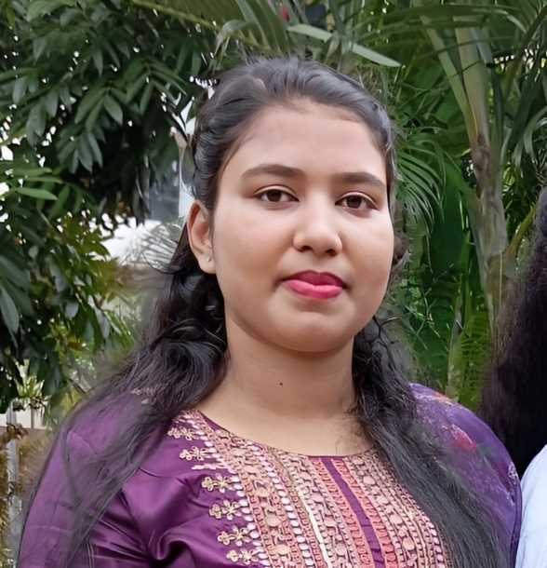
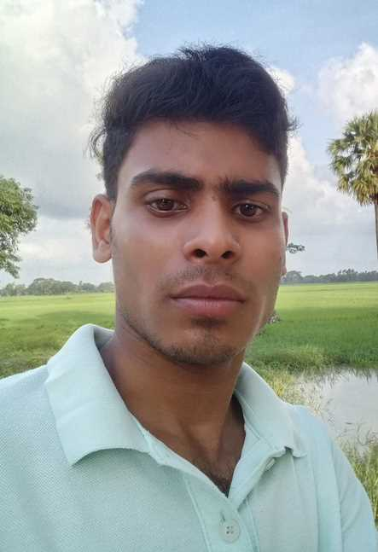
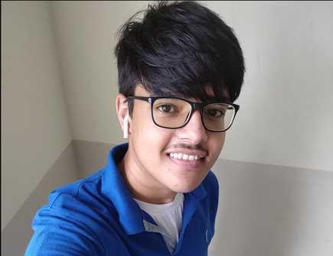
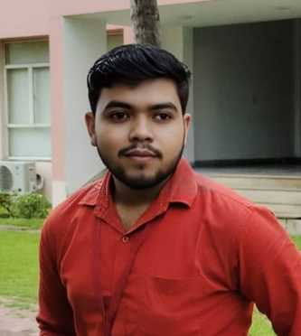
The Space Strikers
MEET OUR TEAM
Jui Dey
Arnesh Pal
Ritik Kumar Singh
3RD YEAR (CSE)
Writing & Communication
3rd year (CSE)
Arts & Web design
3RD YEAR (CSE)
Presentation, Hardware
& Public Speaking
Amitava Kar
Soumitra Mondal
Rudrasom Shee
3RD YEAR (CSE)
Coding & web development
3RD YEAR (CSE)
Presentation, Hardware
& Public Speaking
3RD YEAR (CSE)
Video editing & Frontend

Slide 3
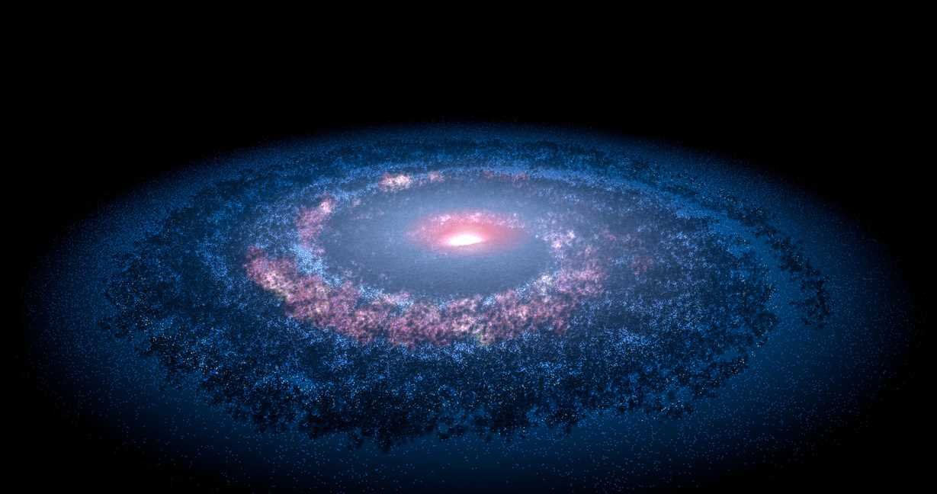

The Space Strikers
PROBLEM STATEMENT?
2023 is the Year of Open Science! Sharing success stories is a great way to showcase the wonderful open science work accomplished by the global community, and provides real-world examples of successful ways to integrate open science into the scientific workflow. Your challenge is to tell an open science success story in a creative way using any form of storytelling—from singing to poetry to dance to puppetry to acrobatics and beyond!

Slide 4


The Space Strikers
OUR SOLUTION STATEMENT
1. Exciting Space Stories: Our website shares amazing space stories using 3D videos, poems, cool pictures, and easy-to-understand research.
2. Making Space Simple: We explain space stuff in a simple way so that anyone, even if you're not a scientist, can enjoy and understand it.
3. Space Lovers' Club: You can chat with other space fans, scientists, and storytellers on our site. We all share our space stories, poems, pictures, and research. It's like a big space-loving club!

Slide 5
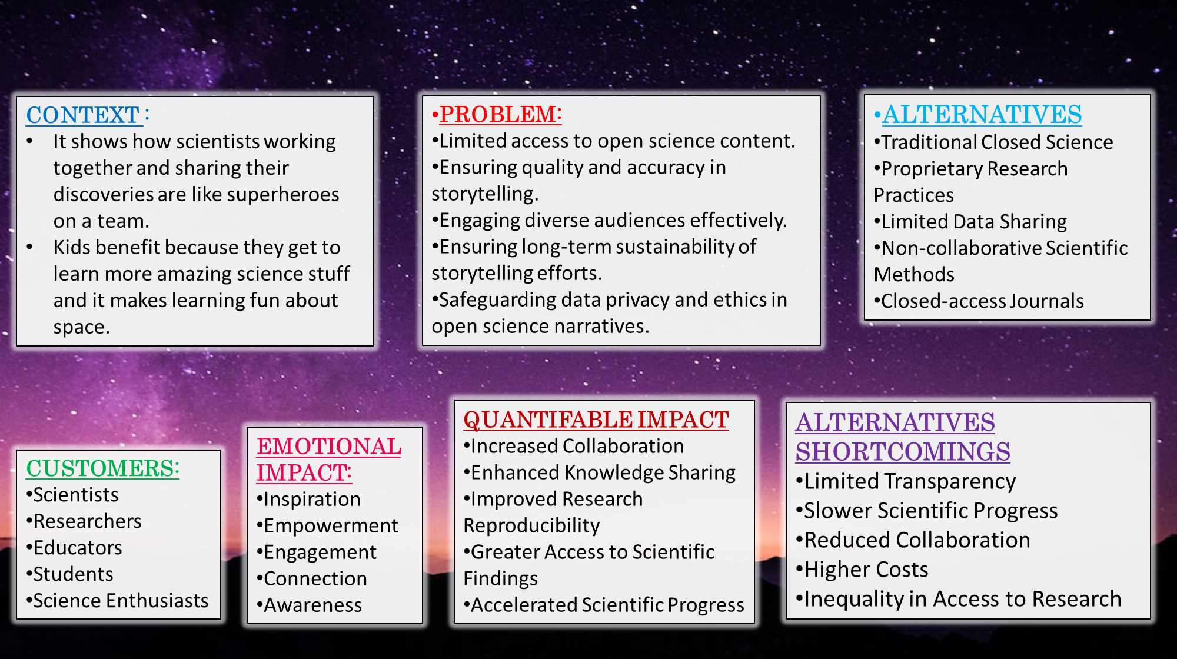
LEAN CANVAS

Slide 6
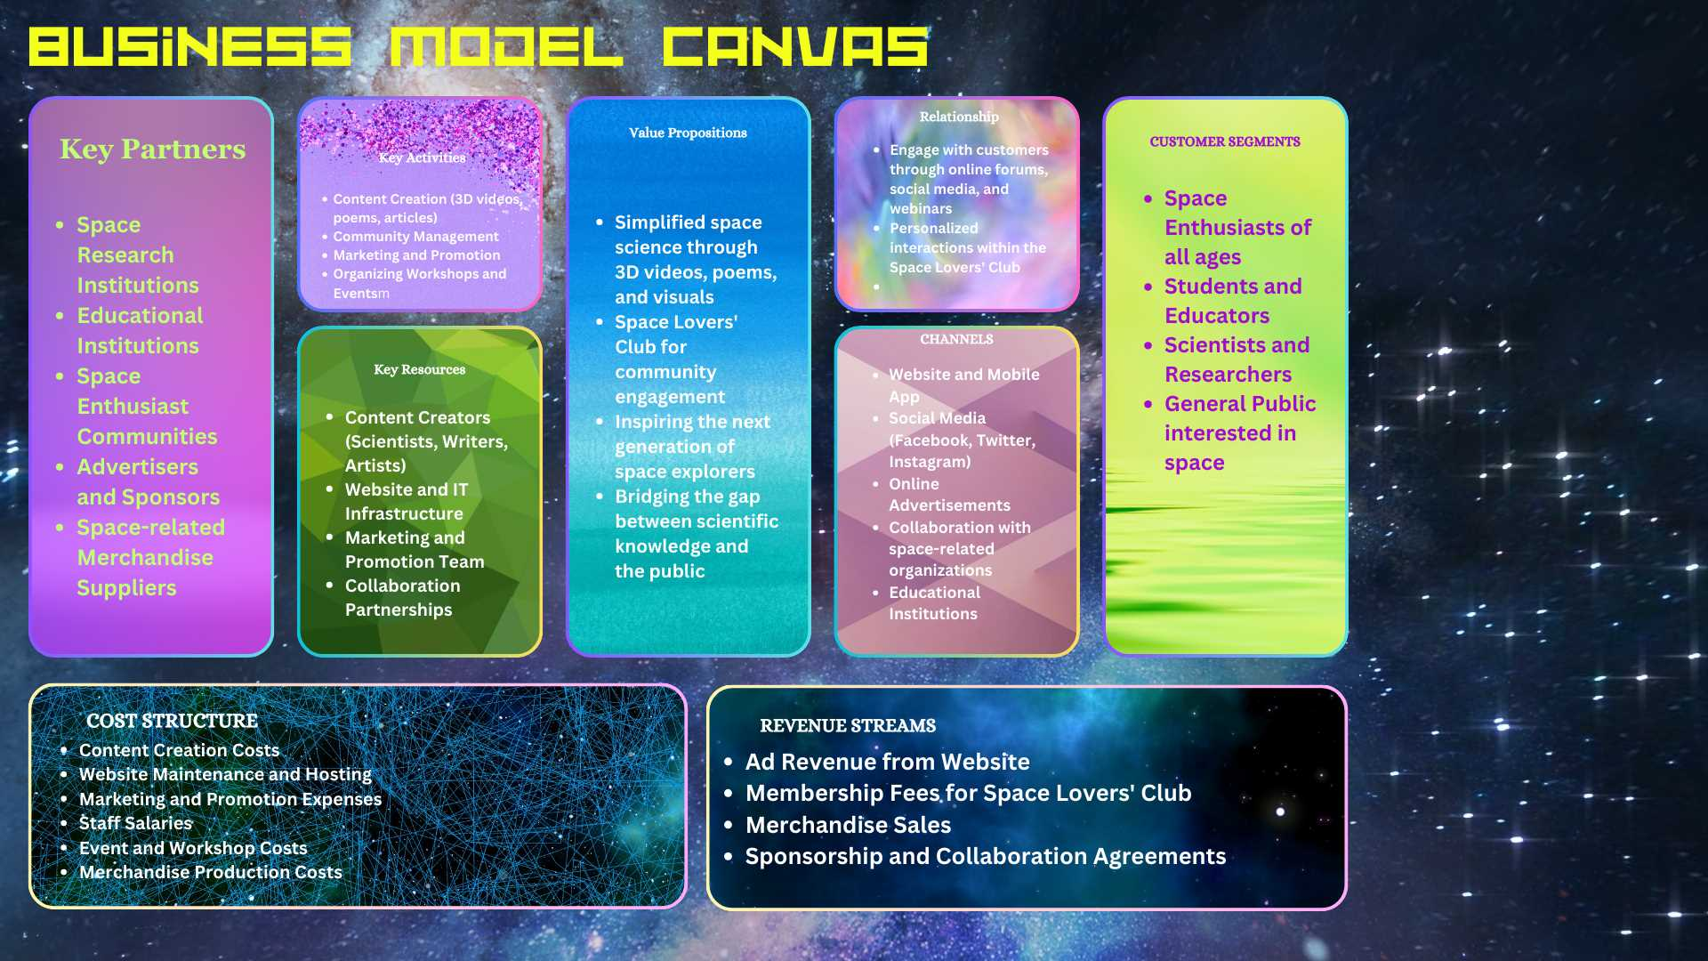

Slide 7



The Space Strikers
WHY THIS IS GREAT?
Our website aims to spark the curiosity and dreams of future space explorers. We want to encourage kids and adults to aim for the stars and maybe become astronauts or scientists one day through our engaging open science storytelling.
Website :
https://arnesh-pal.github.io/Space_Strikers/index.html

